Slide 1
Basic Programming Concepts

Slide 2
Week Agenda
Day 1.
Basic Programming concepts
Variables
Data types
Loops
Functions
Operators
Conditions
Syntax
Data Structures
Debugging
Day 2.
Object oriented programming
Abstraction
Encapsulation
Inheritance
Polymorphism
Day 3
Object Oriented Programming
Classes
Interfaces
Exceptions
Advanced Data Structures
Lists
HashMaps
Queue
ArrayList
Notes:
Variables - Allow the computer to remember numbers and variables in order to perform calculations
Program is a set of instructions - use ikea example
System.out.println
When using double quotes, the string literal will print
When no quotes, computer assumes variable, and will print the value of the variable
Variables (use the bus memory game)
Rules
Variable names are case sensitive
Variable names must start with a letter
Cannot have white spaces
Primitive types
Byte
short
Integer
Declared int, because programmer are lazy
limited to 2147483647 because that is the maximum a number can be while maintaining 4 byes of memory
Long
limited to 2147483647*e^7 because that is the maximum a number can be while maintaining 4 byes of memory
Double
Used to store fractions
Up to 8 bytes of memory
Float
Used to store fractions
up to 4 byes in memory
Char
Use to store a single character (a-z0-9!@#$ ect.)
Can set a char to ‘3’ but
Cannot set a char to ‘10’
Boolean
TRUE OR FALSE, OR 1 OR 0
Declaring a variable
Variables are null until initialized
Operators
+, -, *, /, %, !
Arithmetic Operators
Addition operator
Sums two numbers
Concatenates strings or characters
Aside from Strings and some Wrapper classes, this operator does not work on Objects
Subtraction
subtracts two numbers
This operator does not work on Objects
Multiplcation
Multiplies two numbers
Also does not work on Objects
Division
Divides two numbers
If two ints are being divided, this operator will return an int whatsoever
To retain the fraction, cast or change one of the numbers to a double
Modulus
Comparison operators
>, <, ==, !=
Boolean Operators
&&, ||, !
And (&&)
Or (||)
Negation (!)
Data Types
Two main types
Primitives
Objects
Strings
String literal
Methods
concatenation
casting
nexr
IF statements
Tests a condition by evaluated a boolean
If true, execute the block code
Else Statement
In the case that the if statement evaluates a false boolean
You can specify an alternative code to execute
Else IF
If the previous if statement returns false,
You can evaluated another boolean
Nested If statements
Switch / Case
Great for when there are a lot of conditions to check.
Run faster than if statements when there is a long list of conditions
Functions
Give the ability to resuse code
A group of code to perform a specific task
Scenario of using functions
Code that adds two numbers together that you want to use repeatedly to keep track of expenses
A friend wants to share restaurant rating code with you
You use alarm setting code in multiple clocks, but the code has a mistake in it that you need to fix
Function definition
Access modifiers (public, private, protected)
Return type
Function signature
Callling a function
Passing variables or literals
Argument order is very important
Like using a dictionary
The book holds the definition word
Our voice calls the word
Parameters and arguments
Loops
While loops
Alarm clock example

Slide 3
Overview
Variables
Group Activity
Rules
Data Types
Operators
Arithmetic
Comparison
Logical
Conditional Statements
Functions
Loops
Language
Syntax
Semantics
Programs
Instructions
Bugs/Errors
Constraints
Group Activity

Slide 4
https://github.com/daversmith/oop
Git repository

Slide 5
If time permits
Exceptions
Debugging

Slide 6
Language
A method of communication, either spoken or written, consisting of the use of words in a structured or conventional way.

Slide 7
Language
Sentence
The basic unit of language which expresses a complete thought.
Follows the grammatical rules of syntax
Syntax
The arrangement of words and phrases to create well-formed sentences
Semantics
Relating to meaning

Slide 8
Program
Webster
A planned series of future events, items, or performances
In relation to Computer Science
A list of instructions that tell a computer what to do.

Slide 9
Program
Instructions
Each instruction must be syntactically correct, otherwise the computer will not understand
Computer performs each instruction exactly as given (Semantics)
Bugs / Errors
If the computer does something you do not wish it to do, you found a bug!
If the computer cannot read the instruction, then there is an error.
Constraints
Limitations restrictions

Slide 10
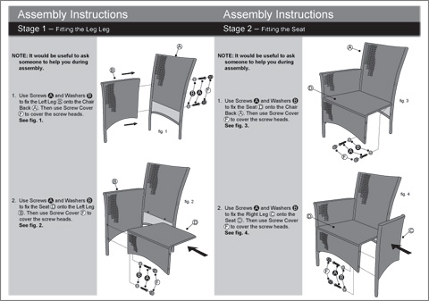
Program
Ikea
Most furniture comes with an instruction booklet (program) to help us assemble.
If we instructions make no sense (syntax), we don’t know how to complete.
If we misunderstand a step (semantics), we can assemble the furniture wrong (bug)

Slide 11
Group Activity

Slide 12
Variables
Basically two main types in Java
Primitive Types
Objects

Slide 13
Primitive Types
Numbers
byte
short
int
long
double
float
Alphabetic
char
Boolean

Slide 14
Objects
String
Pretty much everything else

Slide 15
Variable Rules
Variable names ...
are case sensitive
must start with a letter
names cannot have white spaces

Slide 16
Operators
Arithmetic Operators
+, -, /, *, %
Comparison Operators
<, >, ==, !=
Boolean Operators
&&, ||, !

Slide 17
Problem Sets 1

Slide 18
Conditional Statements
IF
Tests a condition by evaluated a boolean
If true, execute the block code
Else Statement
In the case that the if statement evaluates a false boolean
You can specify an alternative code to execute
Else IF
If the previous if statement returns false, You can evaluated another boolean

Slide 19
Switch / Case
A great alternative for If statements when there are a lot of conditions to check
Runs faster that If statements when there is a long list of conditions

Slide 20
Problem Sets 2

Slide 21
Functions
Gives the ability to easily reuse code
A group of code to perform a specific task

Slide 22
Functions
Function definition
Calling a function
Parameters and arguments

Slide 23
Problem Sets 3

Slide 24
Loops
While loops
For loops

Slide 25
Problem Sets 4

Slide 26
Sentence
See Dick run.

Slide 27
Syntax
The rager was turnt AF and bae was on fleek.

Slide 28
Syntax
Kale chips heirloom, ramps street art brunch celiac tofu food truck microdosing.

Slide 29
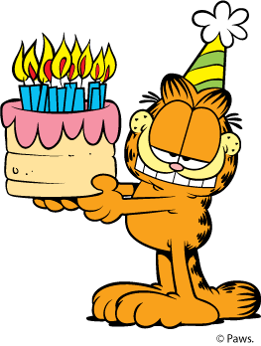
Semantics
Garfield is having a party. Everyone is invited!

Slide 30


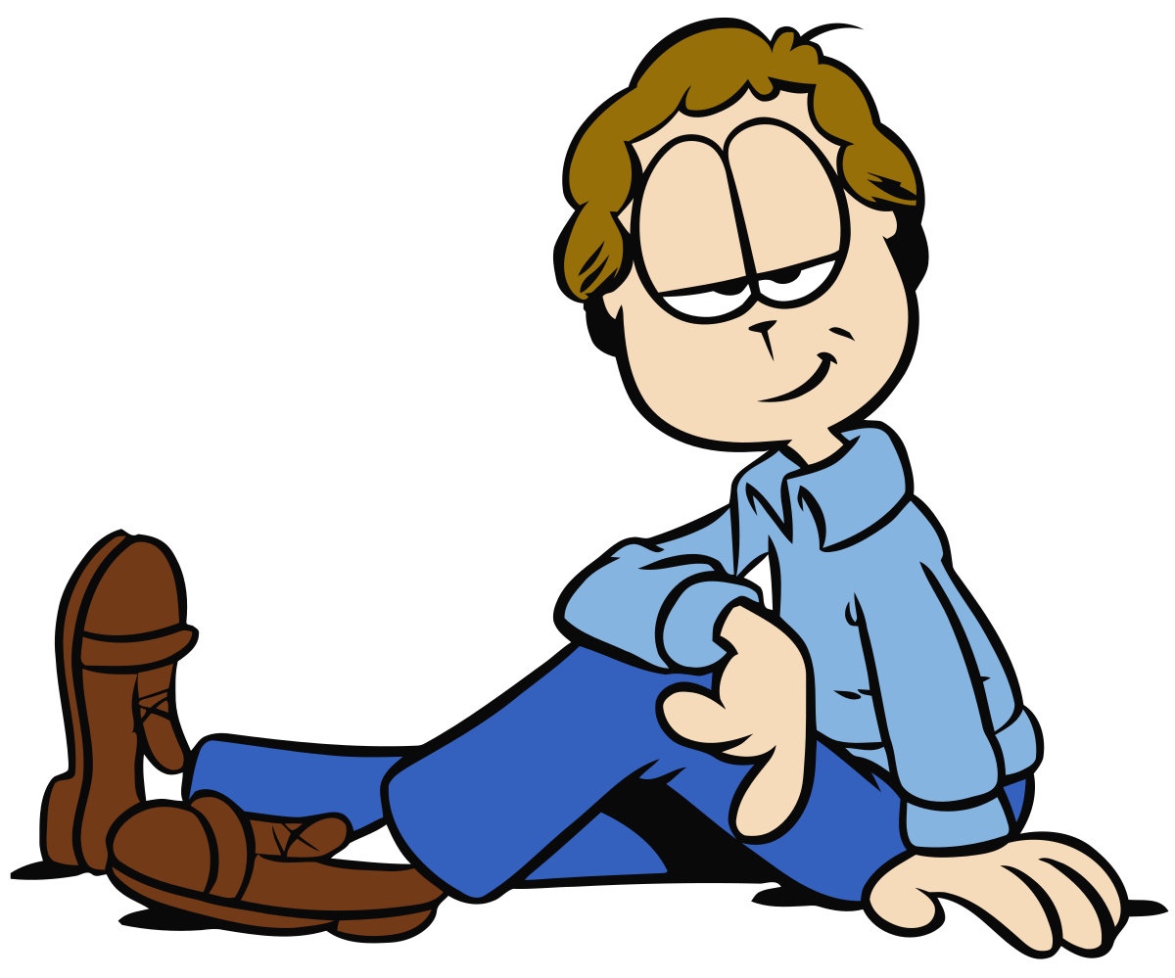
Semantics
Well, everyone is invited as long as they are not Jon or they are not Odie.
Or

Slide 31

Semantics
Garfield hires the best doorman money can buy. The doorman strictly follows Garfield’s rules…...

Slide 32
Semantics
Yet, when Garfield makes his entrance, he sees both Jon and Odie at his party. Why?

Slide 33
Semantics

Slide 34
Group Activity
Help the turtle find her flower.
Rules
The turtle can only read one instruction at a time
The turtle can only move one square at a time
When the turtle turns, it remains in the current square
http://davelements.com/game/

